Slide 1

The Nature of Decision Making
Decision making:
  The act of choosing one alternative from among a set of alternatives.
Decision-making process:
  Recognizing and defining the nature of a decision situation, identifying alternatives, choosing the “best” alternative, and putting it into practice.
9 - <number>

Slide 2

Types of Decisions
Programmed decision:
  A decision that is fairly structured or recurs with some frequency (or both).
Non-programmed decision:
  A decision that is relatively unstructured and occurs much less often than a PROGRAMMED DECISION.
9 - <number>

Slide 3
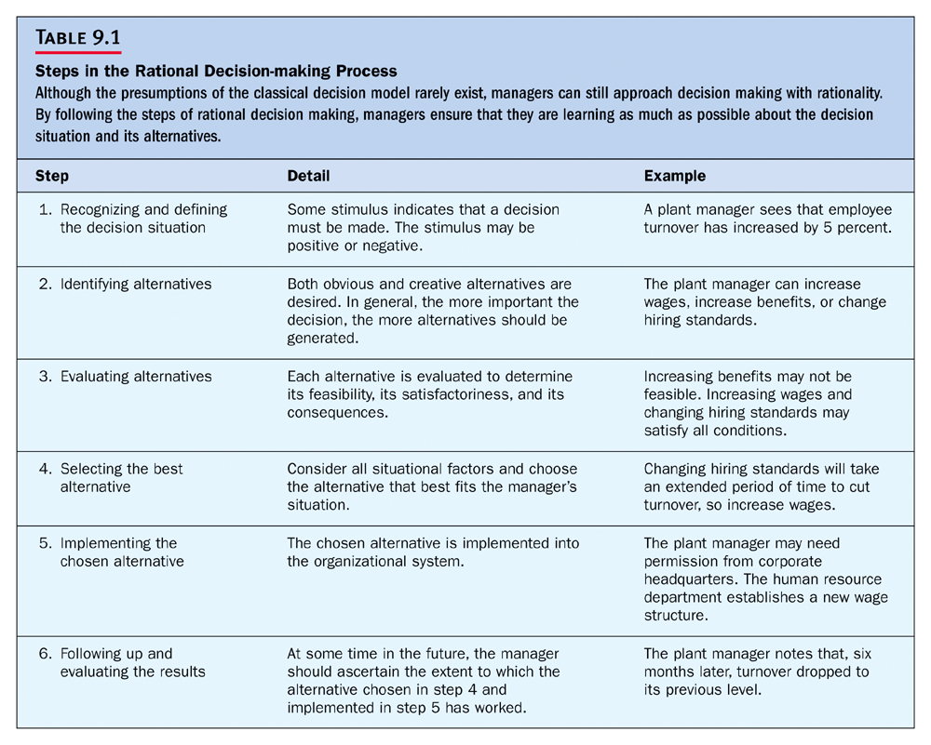
9 - <number>

